Slide 1
THE LIFE OF CHRIST
PART 43
Matthew 14, Mark 6, Luke 9 and John 6

Slide 2
Mark 6:14 Now King Herod heard of Him, for His name had become well known. And he said, "John the Baptist is risen from the dead, and therefore these powers are at work in him." ¹⁵ Others said, "It is Elijah." And others said, "It is the Prophet, or like one of the prophets." ¹⁶ But when Herod heard, he said, "This is John, whom I beheaded; he has been raised from the dead!" ¹⁷ For Herod himself had sent and laid hold of John, and bound him in prison for the sake of Herodias, his brother Philip's wife; for he had married her. ¹⁸ For John had said to Herod, "It is not lawful for you to have your brother's wife."

Slide 3
¹⁹ Therefore Herodias held it against him and wanted to kill him, but she could not; ²⁰ for Herod feared John, knowing that he was a just and holy man, and he protected him. And when he heard him, he did many things, and heard him gladly.

Slide 4
His first marriage was to a daughter of Aretas, the Arabian king; but on a visit to Rome he met Herodias his brother's wife (Philip, not the tetrarch), whom he seduced and married. The outrage of this union was compounded by the element of incest. Aretas took vengeance upon Herod by defeating him in a war. Herod applied to Caesar for a crown, but was banished to Lugdunum, in which exile Herodias shared.

Slide 5
This woman was a daughter of Herod I's son, Aristobulus. She first married her uncle Philip who was living as a private citizen in Rome, and by him she had Salome. When Herod Antipas was visiting in Rome, she left Philip and married his brother Herod Antipas.

Slide 6
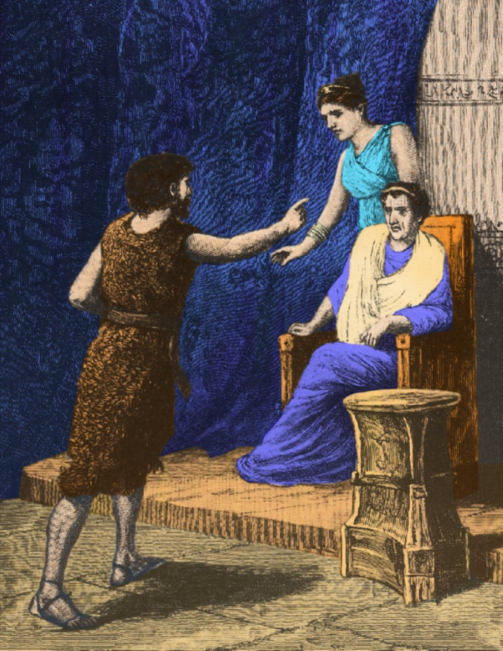
Matthew 14:4 Because John had said to him, "It is not lawful for you to have her." ⁵ And although he wanted to put him to death, he feared the multitude, because they counted him as a prophet.

Slide 7
1 Peter 3:15 But sanctify the Lord God in your hearts, and always be ready to give a defense to everyone who asks you a reason for the hope that is in you, with meekness and fear; ¹⁶ having a good conscience, that when they defame you as evildoers, those who revile your good conduct in Christ may be ashamed.

Slide 8
Leviticus 18:16 'You shall not uncover the nakedness of your brother's wife; it is your brother's nakedness.
Leviticus 20:21 'If a man takes his brother's wife, it is an unclean thing. He has uncovered his brother's nakedness. They shall be childless.

Slide 9
And when he heard him, he did many things, and heard him gladly.

Slide 10
Ezekiel 33:31 "So they come to you as people do, they sit before you as My people, and they hear your words, but they do not do them; for with their mouth they show much love, but their hearts pursue their own gain. ³² "Indeed you are to them as a very lovely song of one who has a pleasant voice and can play well on an instrument; for they hear your words, but they do not do them. ³³ "And when this comes to pass -- surely it will come -- then they will know that a prophet has been among them."

Slide 11
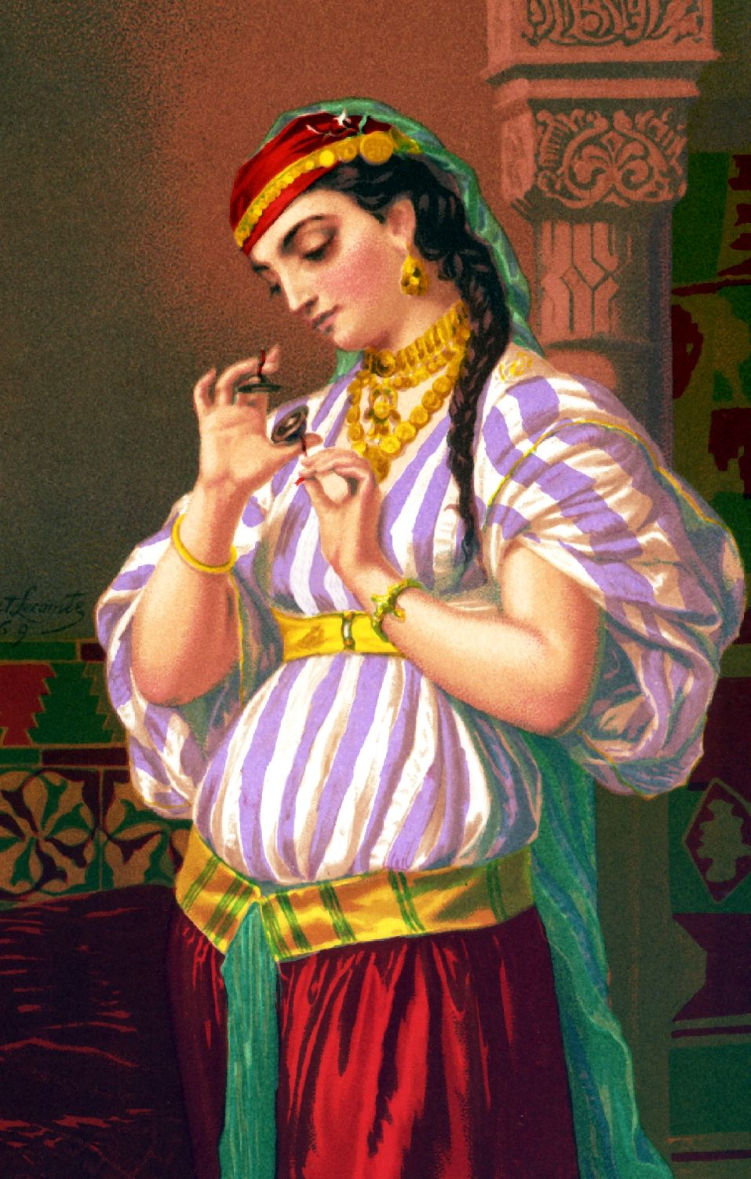
Mark 6:21 Then an opportune day came when Herod on his birthday gave a feast for his nobles, the high officers, and the chief men of Galilee. ²² And when Herodias' daughter herself came in and danced, and pleased Herod and those who sat with him, the king said to the girl, "Ask me whatever you want, and I will give it to you." ²³ He also swore to her, "Whatever you ask me, I will give you, up to half of my kingdom."

Slide 12
Mark 6:24 So she went out and said to her mother, "What shall I ask?" And she said, "The head of John the Baptist!" ²⁵ Immediately she came in with haste to the king and asked, saying, "I want you to give me at once the head of John the Baptist on a platter." ²⁶ And the king was exceedingly sorry; yet, because of the oaths and because of those who sat with him, he did not want to refuse her.

Slide 13
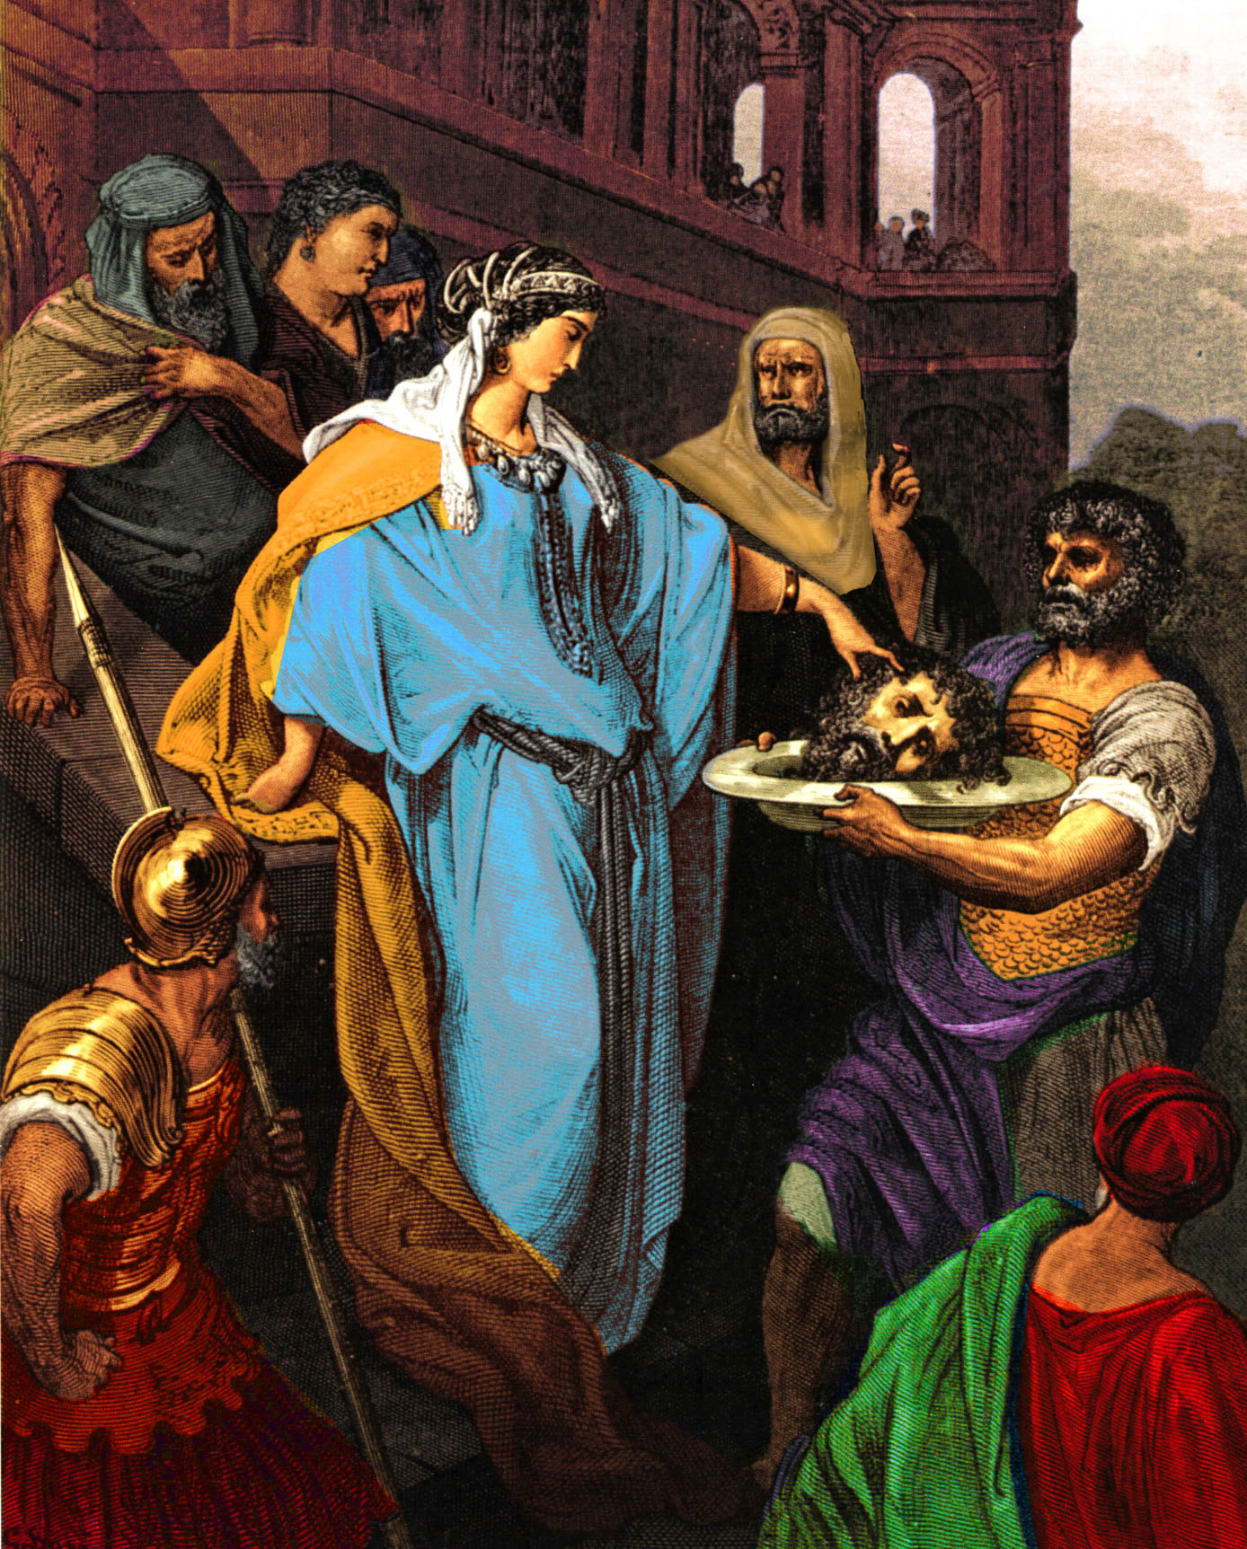
Mark 6:27 Immediately the king sent an executioner and commanded his head to be brought. And he went and beheaded him in prison, ²⁸ brought his head on a platter, and gave it to the girl; and the girl gave it to her mother. ²⁹ When his disciples heard of it, they came and took away his corpse and laid it in a tomb.

Slide 14
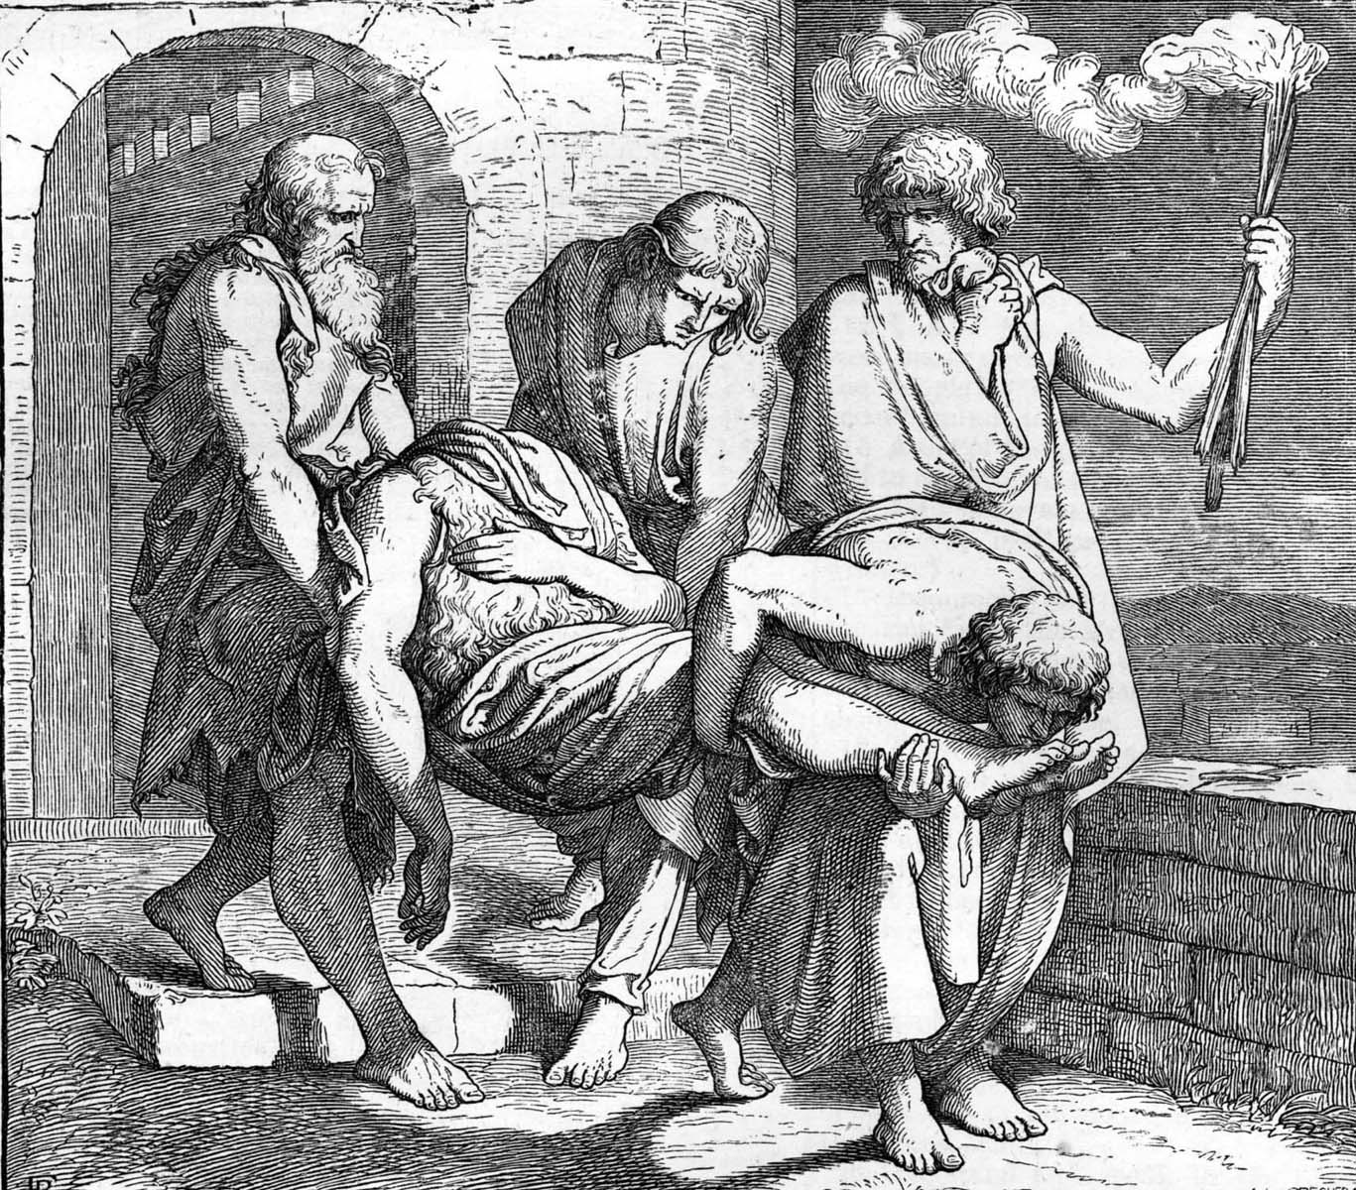
Luke 7:28 "For I say to you, among those born of women there is not a greater prophet than John the Baptist

Slide 15
Mark 6:30 Then the apostles gathered to Jesus and told Him all things, both what they had done and what they had taught. ³¹ And He said to them, "Come aside by yourselves to a deserted place and rest a while." For there were many coming and going, and they did not even have time to eat. ³² So they departed to a deserted place in the boat by themselves.

Slide 16
Matthew 14, Mark 6, Luke 9, and John 6 record the feeding of the 5000.

Slide 17
John 6:1 After these things Jesus went over the Sea of Galilee, which is the Sea of Tiberias. ² Then a great multitude followed Him, because they saw His signs which He performed on those who were diseased. ³ And Jesus went up on the mountain, and there He sat with His disciples. ⁴ Now the Passover, a feast of the Jews, was near.

Slide 18
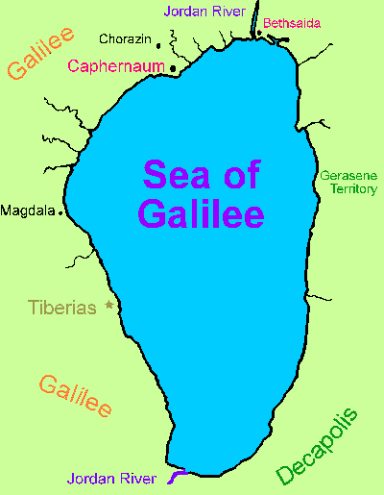
The Sea of Galilee has had many names such as, Sea of Chinnereth (Num. 34:11), Sea of Chinneroth (Jos. 12:3), Lake Genessaret (Lk. 5:1), and the Sea of Tiberias as used here. It received this latter name because of the city Tiberius located on the western shore, which Herod Antipas founded around A.D. 20 and named in honor of Emperor Tiberius (F.F. Bruce - The Gospel & Epistles of John p. 142).

Slide 19
John 6:5 Then Jesus lifted up His eyes, and seeing a great multitude coming toward Him, He said to Philip, "Where shall we buy bread, that these may eat?" ⁶ But this He said to test him, for He Himself knew what He would do. ⁷ Philip answered Him, "Two hundred denarii worth of bread is not sufficient for them, that every one of them may have a little."

Slide 20
Mark 6:35 When the day was now far spent, His disciples came to Him and said, "This is a deserted place, and already the hour is late. ³⁶ "Send them away, that they may go into the surrounding country and villages and buy themselves bread; for they have nothing to eat." ³⁷ But He answered and said to them, "You give them something to eat." And they said to Him, "Shall we go and buy two hundred denarii worth of bread and give them something to eat?" ³⁸ But He said to them, "How many loaves do you have? Go and see." And when they found out they said, "Five, and two fish." (See also Mt. 14:15-17; Lk. 9:12-13)

Slide 21
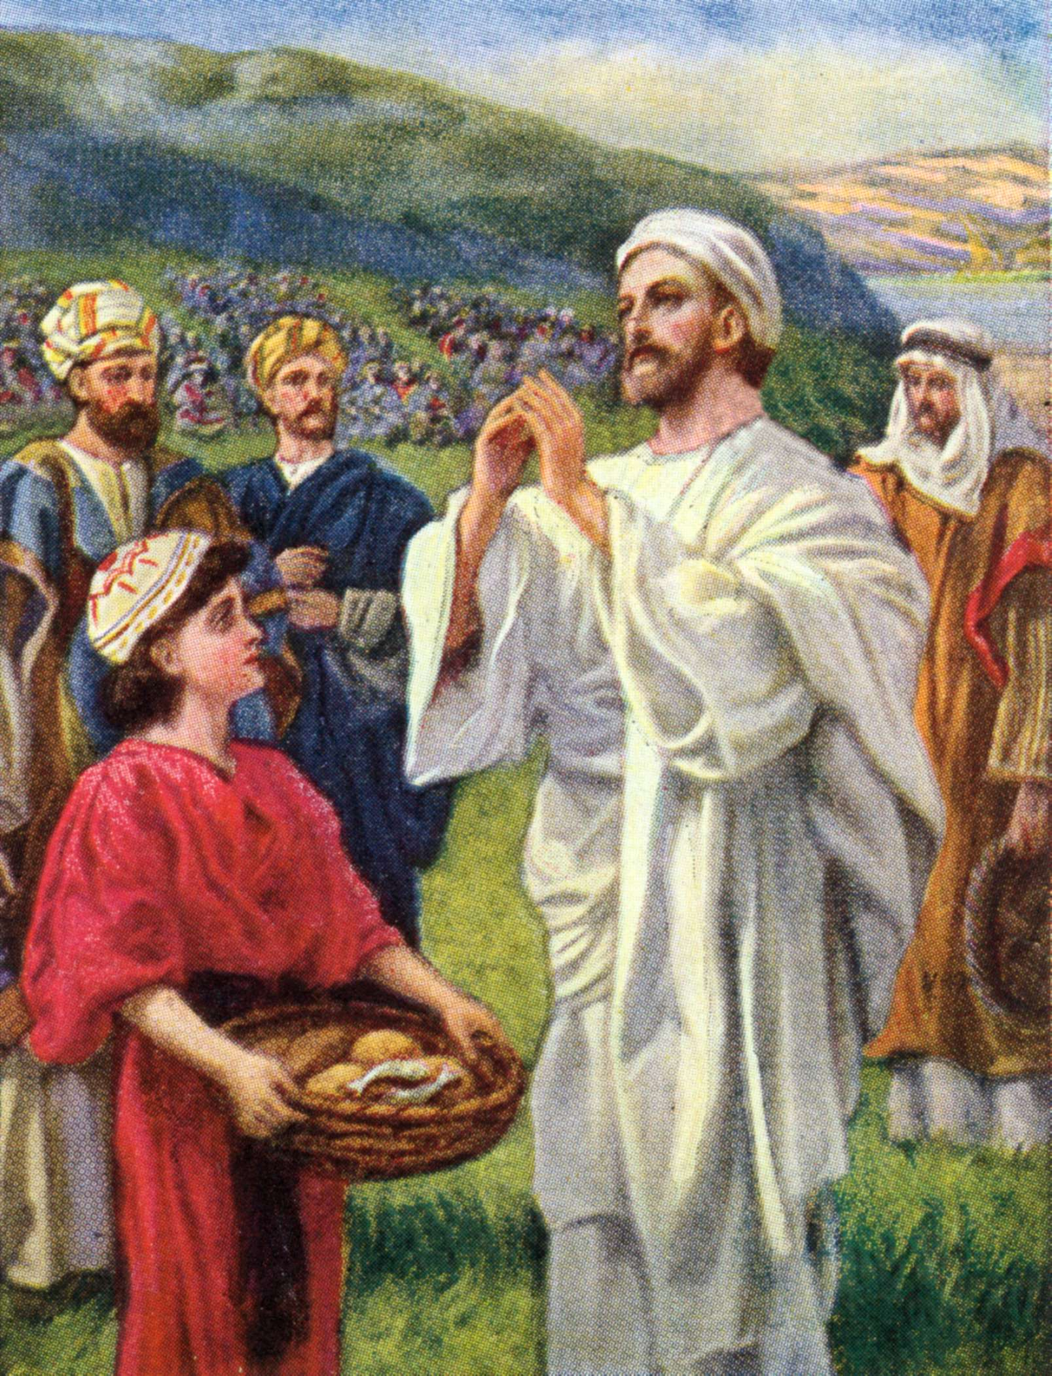
John 6:8 One of His disciples, Andrew, Simon Peter's brother, said to Him, ⁹ "There is a lad here who has five barley loaves and two small fish, but what are they among so many?"

Slide 22
Thayer’s Lexicons describes it this way: “ Food composed of flour mixed with water and baked; the Israelites made it in the form of an oblong or round cake, as thick as one's thumb, and as large as a plate or platter …”

Slide 23
John 6:10 Then Jesus said, "Make the people sit down." Now there was much grass in the place. So the men sat down, in number about five thousand.

Slide 24
The other versions translate the meaning of this Greek word better because the NKJV uses “deserted”, the NIV uses “remote place”, and the ESV uses “desolate place.” This place was a quiet uninhabited place and not only was there grass there, it was green (Mk. 6:39). Jesus had His disciples sit these people down in groups of 50 and 100 (Mk. 6:40).

Slide 25
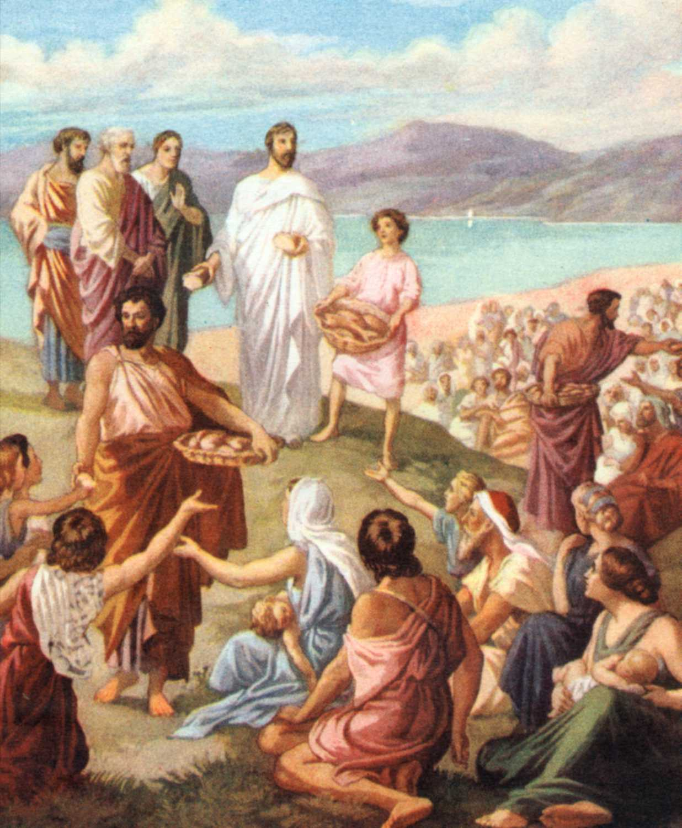
John 6:11 And Jesus took the loaves, and when He had given thanks He distributed them to the disciples, and the disciples to those sitting down; and likewise of the fish, as much as they wanted.

Slide 26
1 Timothy 4:4 For every creature of God is good, and nothing is to be refused if it is received with thanksgiving; ⁵ for it is sanctified by the word of God and prayer.

Slide 27
Ephesians 5:18 And do not be drunk with wine, in which is dissipation; but be filled with the Spirit, ¹⁹ speaking to one another in psalms and hymns and spiritual songs, singing and making melody in your heart to the Lord, ²⁰ giving thanks always for all things to God the Father in the name of our Lord Jesus Christ,

Slide 28
John 6:12 So when they were filled, He said to His disciples, "Gather up the fragments that remain, so that nothing is lost." ¹³ Therefore they gathered them up, and filled twelve baskets with the fragments of the five barley loaves which were left over by those who had eaten.

Slide 29
John 6:14 Then those men, when they had seen the sign that Jesus did, said, "This is truly the Prophet who is to come into the world."

Slide 30
John 6:15 Therefore when Jesus perceived that they were about to come and take Him by force to make Him king, He departed again to the mountain by Himself alone.

Slide 31
